Slide 1
14.6 Random Forests

Slide 2
Unless human interpretability of the final model is of primary concern, one virtually never uses a single recursively defined regression or classification tree, but a bagged ensemble of them.
Each individual tree can be trained on a random portion of training data taken from the original dataset and grown to a predetermined maximum depth, and afterwards bagged together.
Such an ensemble of recursively defined trees is often called a "random forest."

Slide 3
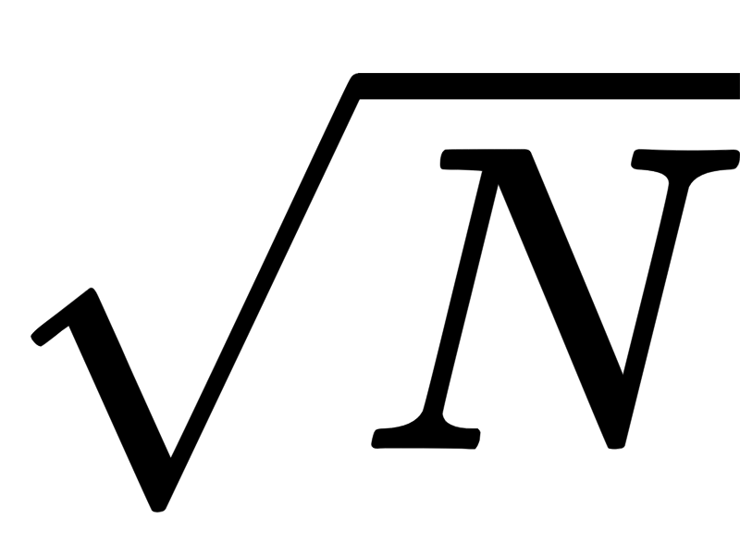
The ”random” part of the name random forest refers both to the fact that:
each tree uses a random portion of the original data as training (which, by convention, is often sampled from the original dataset with replacement)
often only a random subset (something like ) of N input feature dimensions are sampled for viable split points at each node in the trees produced

Slide 4
While trees can certainly overfit, even when not cross-validated they are naturally prevented from exhibiting the sort of wild oscillatory overfitting behavior that is readily possible with fixed-shape or neural network models.
Moreover, because each fully grown tree in such an ensemble can be learned efficiently, the computational trade-off, that is, training a large number of fully grown trees compared with a smaller number of cross-validated ones (each of which require more resources to construct), is often advantageous in practice.

Slide 5
Figure below shows the result of bagging a set of five fully grown classification trees trained on different random portions of a simple two-class dataset
training data: black boundary
validation data: yellow boundary

Slide 6
